Slide 1
ISI - Integração de Sistemas de Informação
Parte 3
MSSIS and Kettle Installation
Instituto Politécnico do Cávado do Ave
Escola Superior de Tecnologia

Slide 2
ISI
  ETL
  ETL is the acronym for Extraction, Transformation, and Loading, which is used to describe the data-processing layer in a data - integration or data warehouse solution⁽¹⁾.
    Problem
    Design
    Solution

Slide 3
ISI
Pentaho Kettle Installation
  Download JAVA
    https://java.com/pt_BR/download/windows-64bit.jsp
    https://www.java.com/en/download/manual.jsp
    Controlar JAVA_HOME
  Download Pentaho Data Integration - Kettle
    https://community.hitachivantara.com/s/article/data-integration-kettle
    https://help.pentaho.com/Documentation/6.1/0F0/0L0/030/010
    https://wiki.pentaho.com/display/EAI/Latest+Pentaho+Data+Integration+%28aka+Kettle%29+Documentation

Slide 4
ISI
  MSSIS (Microsoft SQL Server Integration Services) installation
  First, read:
  SQL Server Data Tools
  https://msdn.microsoft.com/pt-pt/mt186501
  https://msdn.microsoft.com/en-US/library/hh272686(VS.103).aspx
  Working with MSSIS
  https://msdn.microsoft.com/en-us/library/ms170057(v=sql.110).aspx

Slide 5
ISI
MSSIS installation
  Install SQL Server Business Intelligence (Development Studio)
    Installing SQLServer with Integration Services
  Install SQL Server Data Tools (Visual Studio MSSIS Template)
    on-line (SSDTSetup.exe)
    via ISO (SSDT_14.0.60923.0_EN.iso)
    https://www.microsoft.com/en-us/download/confirmation.aspx?id=42313
  Install SQL Server Management Studio

Slide 6
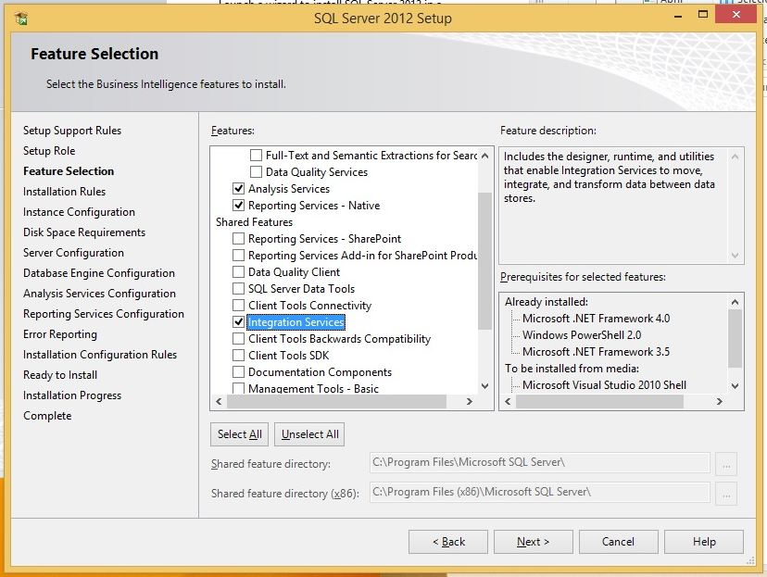
ISI
MSSIS Installation

Slide 7
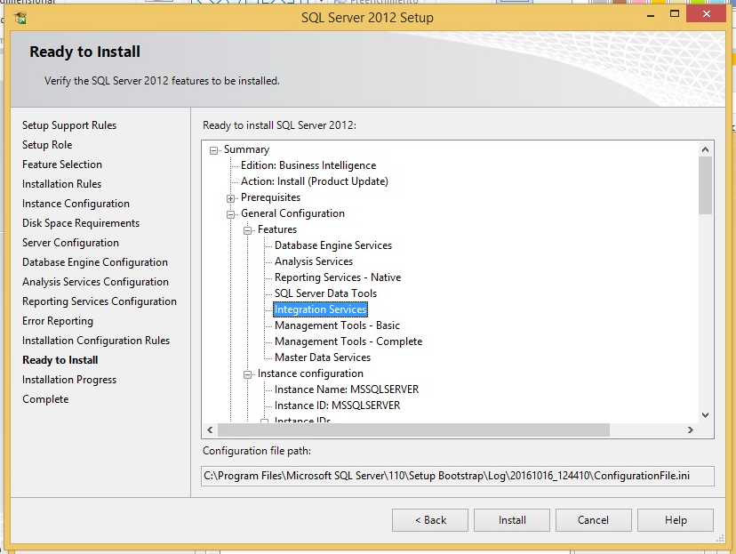
ISI
MSSIS Installation

Slide 8
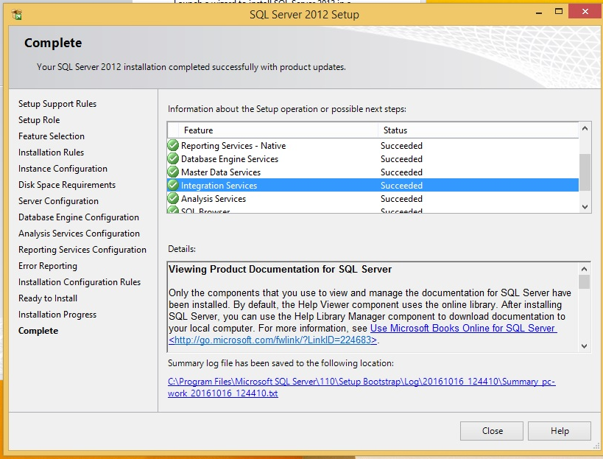
ISI
MSSIS Installation

Slide 9
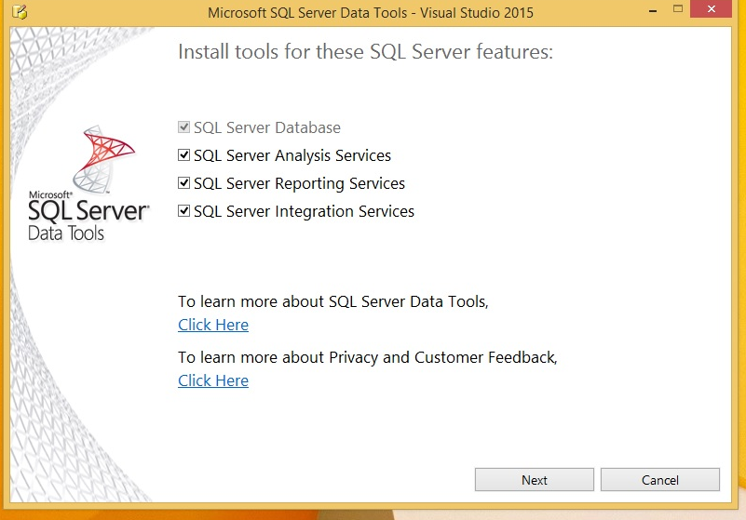
ISI
MSSIS Installation

Slide 10
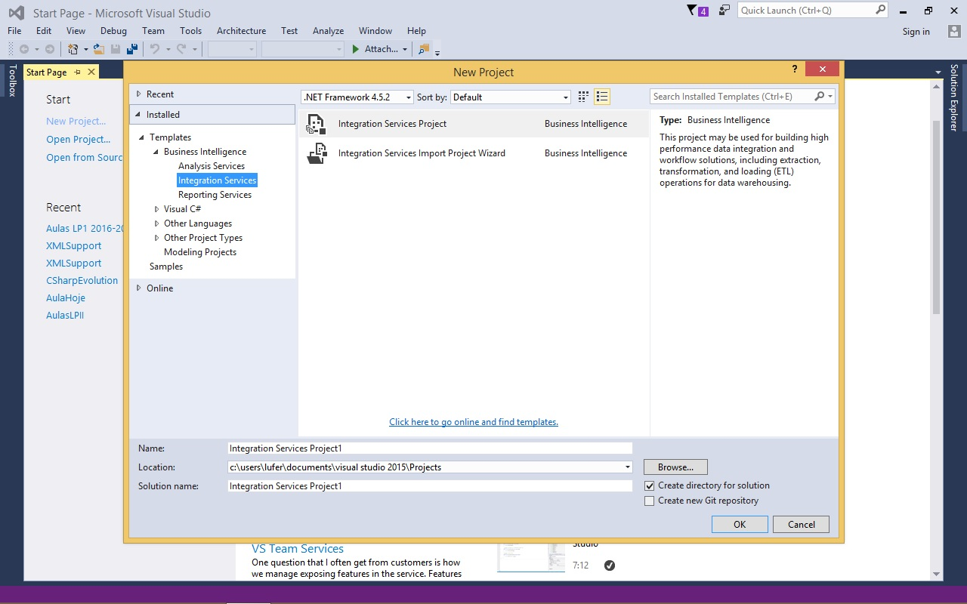
ISI
MSSIS Installation

Slide 11
ISI
My First Integration Services Solution
  https://code.msdn.microsoft.com/My-First-Integration-fa41c0b1
  https://code.msdn.microsoft.com/SSIS-Control-Flow-Basics-16bd36d0
  https://code.msdn.microsoft.com/SSIS-Data-Flow-Basics-f429f5f1

Slide 12
ISI
References
  Microsoft SQL Server Integration Services
  Microsoft®SQL Server®2008 Integration Services: Problem–Design–Solution - Wiley Publishing, Inc., 2010 ⁽¹⁾
URL
  http://msdn.microsoft.com/en-us/library/ms169917%28v=sql.105%29.aspx
  http://www.wiseowl.co.uk/videos/ssis/integration-services.htm
  http://technet.microsoft.com/pt-pt/sqlserver/cc511477.aspx
  http://technet.microsoft.com/en-us/sqlserver/jj737673
  http://social.technet.microsoft.com/wiki/contents/articles/3215.ssis-expression-examples.aspx
  https://www.talend.com/products/data-integration

